Slide 1
Model
Sure. In artificial intelligence (AI),
a model is a mathematical representation of a real-world system.
Models are used to make predictions about the behavior of the system, and they can also be used to control the system.
There are many different types of models in AI, including:
Statistical models are based on statistical data, and they are used to make predictions about future events. For example, a statistical model could be used to predict the weather or the stock market.
Neural networks are inspired by the human brain, and they are used to learn complex relationships between data. For example, a neural network could be used to recognize objects in images or to translate languages.
Rule-based models are based on a set of rules, and they are used to make decisions based on those rules. For example, a rule-based model could be used to determine whether a loan application should be approved or denied.
Models are used in a wide variety of AI applications, including:
Machine learning
Natural language processing
Computer vision
Robotics
Game playing

Slide 2
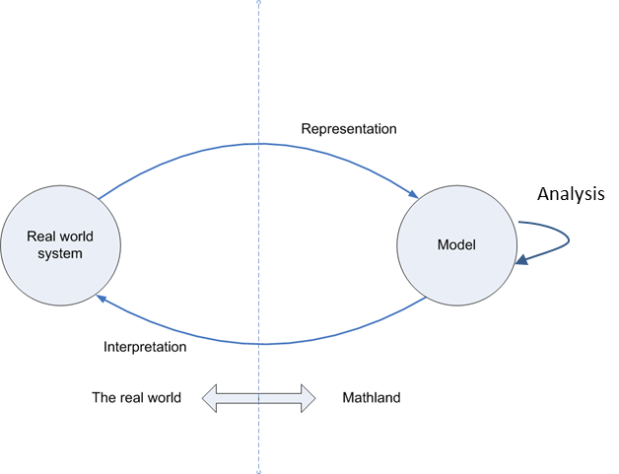
Diagram of Model use and Development

Slide 3
Language Model
A language model in artificial intelligence is a type of model that is trained to understand, generate, and interpret human language.
언어 모델(language model) 또는 언어 모형은 일련의 단어들의 확률 분포이다.

Slide 4
Language models
Language models are trained using a technique called "deep learning," which involves training a large neural network on massive datasets.
How many words trained by chat GPT?
ChatGPT, based on the GPT-3.5 architecture, was trained on a vast amount of data containing 570GB of text. However, it's important to note that the number of words in the training data is not explicitly specified by OpenAI.

Slide 5
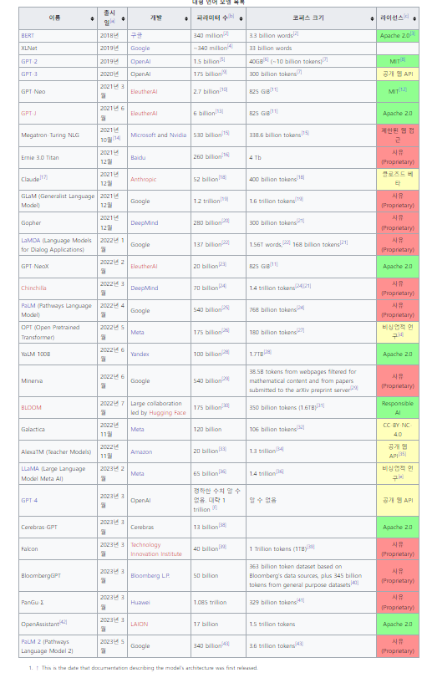
Large Language Model
수많은 파라미터(보통 수십억 웨이트 이상)를 보유한 인공 신경망으로 구성되는 언어 모델이다.
자기 지도 학습이나 반자기지도학습을 사용하여 레이블링되지 않은 상당한 양의 텍스트로 훈련된다.^{[1]}
LLM은 2018년 즈음에 모습을 드러냈으며 다양한 작업을 위해 수행된다.
이전의 특정 작업의 특수한 지도 학습 모델의 훈련 패러다임에서 벗어나 자연어 처리 연구로 초점이 옮겨졌다.

Slide 6
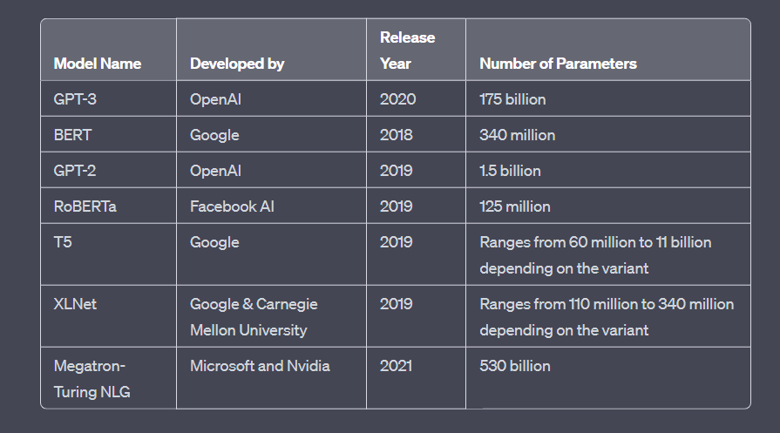
large language models

Slide 7
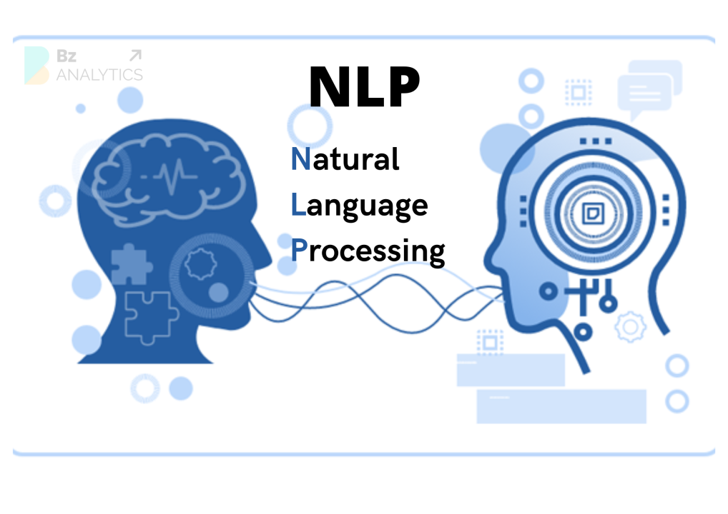

Slide 8
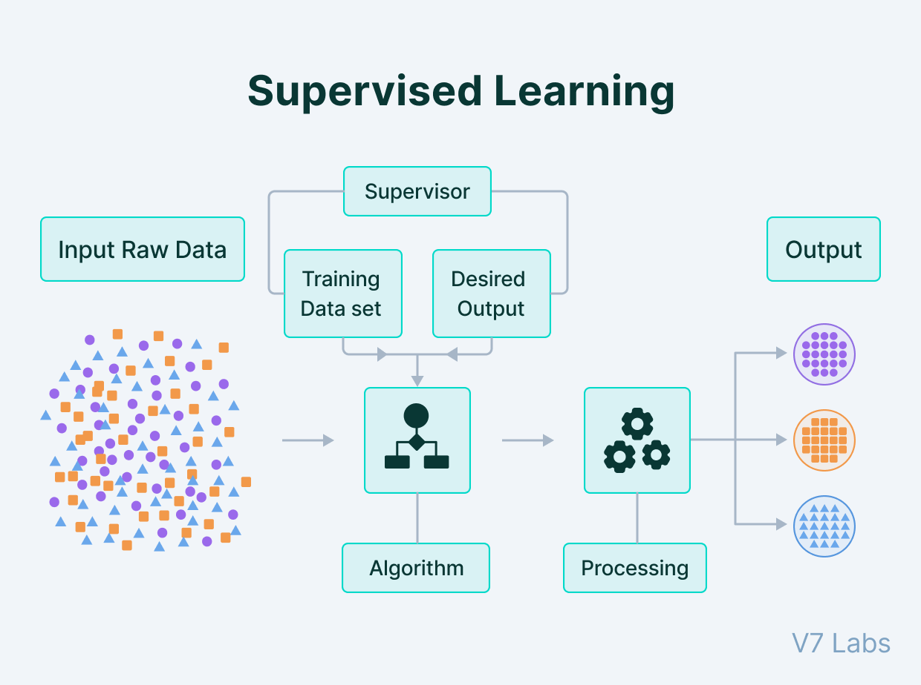

Slide 9
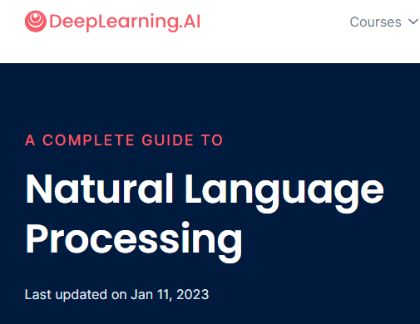
Natural Language Processing
Natural Language Processing (NLP) [A Complete Guide] (deeplearning.ai)

